Slide 1
Report on E-commerce Dataset
Darshan Dattatrey Gavhankar

Slide 2
Dataset Overview:
The dataset contains information about orders placed during the period of January 2017 to September 2018. It includes details such as total product count, the number of customers, the number of orders, the overall revenue generated, customer details, order status, and order prices.
Observations:
Total Products: There are 74 unique products available in the dataset.
Total Customers: The dataset comprises information on approximately 98.96k customers.
Total Orders: During the specified period, there were 103.37k orders placed.
Total States: There are overall 27 states in which our customers are
Overall Revenue: The combined revenue from all orders during the given timeframe amounts to 15.91M .
Overall Customer Review Score: Customers provided an average review score of 4.07 out of 5, reflecting their satisfaction with the products or services received.
Average On-Time Delivery Percentage: The dataset indicates an impressive on-time delivery rate of 88.18%. This percentage signifies the proportion of orders that were delivered punctually to customers.

Slide 3
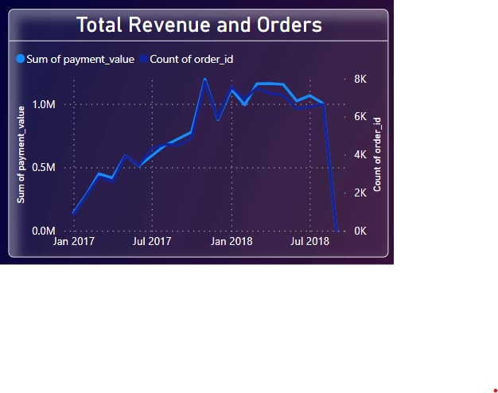
Current State of Business:-
Over the Period of two years, the total revenue generated by the company amounted to 15.91 million . Out of this, the revenue for the year 2017 was 7.23 million , and for the year 2018, it increased to 8.68 million.
Looking at the month-wise sales represented in the line graph, we observe that in November 2017, the company achieved its highest monthly revenue, reaching an impressive 1.19 million. However, the following month, December 2017, experienced a decline in revenue. Despite fluctuations in the market, the company has not been able to surpass that peak revenue since then. Unfortunately, in September 2018, there was a significant drop in revenue, indicating a downturn in the market during that period

Slide 4
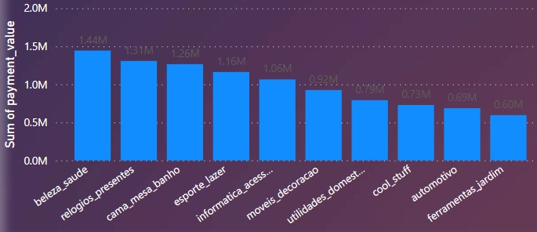
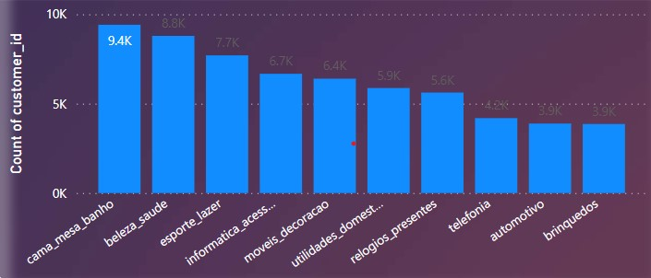
We can see that There are two bar plot one displaying the top 10 products based on their sales revenue, and the other showing the Top 10 products with the Customers.
Among the 74 products in the dataset, the product "Beleza_saude" stands out with the highest sales revenue, amounting to 1.44 million. This product has been purchased by 8,791 customers, making it one of the second most popular choices among customers in terms of sales volume.
While there are several products with substantial sales revenue, "kama mesa bahano" has the highest number of customers buying it, reaching 9,412 customers and total revenue of this is 1.26M.
According to Sales
According to Customers

Slide 5
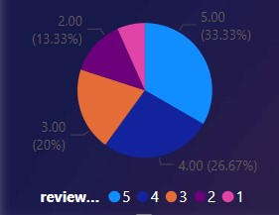
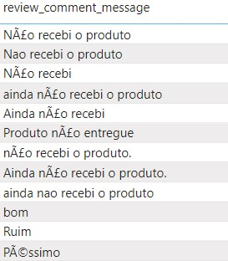
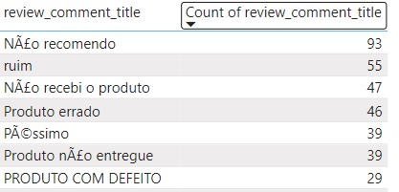
Customer reviews analysis:-
In our current business scenario, we have a total of 98,960 customers. From our customer review data, we have found that approximately 33.33% of customers have given our products a perfect score of 5 out of 5. This is a positive sign that a significant portion of our customer base is highly satisfied with their purchases.
However, we also observed that 6.67% of customers marked their reviews with a score of 1, indicating dissatisfaction with their experience. While this percentage is relatively small, it is crucial for us to address the concerns of these customers promptly and effectively.
Moreover, there is a segment of customers, comprising around 20% of the total, who have provided review scores less than 3. This indicates that there are areas in our business where improvements are needed to enhance customer satisfaction and drive higher sales.
As a Data Scientist/Business Analyst, it is recommended that we focus our efforts on identifying and addressing the pain points of this 20% customer segment. By proactively addressing their concerns and improving their overall experience, we can potentially convert dissatisfied customers into loyal advocates for our brand. Implementing customer feedback mechanisms and closely monitoring product performance can aid in driving the necessary changes.
Furthermore, we should prioritize efforts to improve the delivery time for our products, as it is often a critical factor affecting customer satisfaction. Timely and reliable deliveries can significantly enhance the overall customer experience.
Additionally, analyzing product performance, particularly those products with lower ratings, will enable us to identify areas of improvement and implement necessary adjustments or product enhancements.
By focusing on these areas of improvement, we can ensure that our business remains customer-centric and strives for continuous enhancement of the customer experience, ultimately leading to increased sales and sustainable growth for A&B Co.

Slide 6
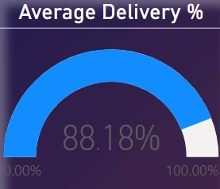
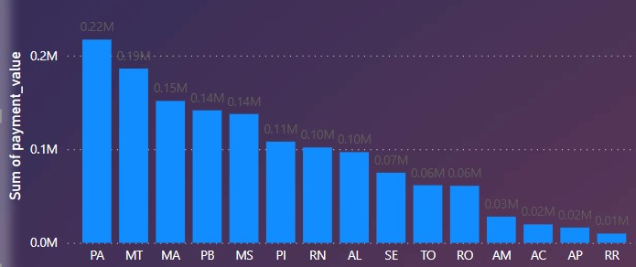
Areas for Improvement:
The average on-time delivery percentage shown in the plot indicates that about 88.18% of orders are delivered on time out of 100%. To enhance our sales and customer satisfaction, it's important to work on improving the delivery rate.
Specifically, we have noticed that the on-time delivery rate in certain states, namely Alabama, Roraima, Plaul, and Massachusetts, is below 80%. This indicates a need to focus on improving the delivery performance in these areas.
By addressing the delivery process in these regions and ensuring that orders are delivered promptly, we can increase customer satisfaction, loyalty, and ultimately boost our sales. Timely and reliable deliveries play a crucial role in creating a positive customer experience, which can lead to long-term business success
The bar plot displays the bottom 15 states based on the sales they have in their cities. These states have relatively fewer customers compared to other regions.
So we need to focus on need and trend of this states to improve our sales in this area.

Slide 7
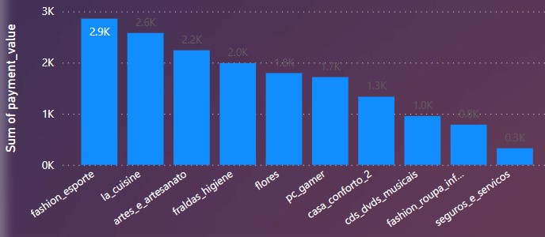
The dataset includes a bar plot representing the bottom 10 products based on their sales revenue and customer count.
Among these products, "seguros e servicos" stands out as the least successful one in terms of both sales revenue and customer adoption.
Specifically, "seguros e servicos" has the lowest sales revenue, amounting to only 0.3 thousand units (currency or monetary unit). Additionally, this product has a very limited customer base, with just one customer purchasing it.
The bar plot provides valuable insights into the overall product performance. It reveals the less successful products that require attention and improvement to boost their sales and attract more customers.
Analyzing this information can help in making strategic decisions to enhance the overall business performance and customer satisfaction. Identifying underperforming products allows businesses to focus on refining their marketing strategies, improving product quality, or introducing new features to attract more customers and drive higher sales. By addressing the challenges faced by low-performing products, companies can work towards achieving a more balanced and successful product portfolio.

Slide 8
Conclusion:-
To improve sales and customer engagement in these specific states, focused efforts are required. Here are some strategies that can be implemented:
Market Research: Conduct in-depth market research in these states to understand the local preferences, needs, and demands of customers. This will help tailor products and services to better suit the target audience.
Marketing Campaigns: Develop targeted marketing campaigns specifically for these regions. Utilize localized advertising and promotions to create awareness and attract more customers.
Customer Engagement: Implement customer engagement programs to build stronger relationships with existing customers. Providing personalized offers, discounts, and incentives can encourage repeat purchases and loyalty.
Product Adaptation: Analyze the product offerings and identify any necessary adaptations to meet the preferences of customers in these states. Customizing products to suit regional tastes can increase their appeal.
Customer Support: Ensure excellent customer support services to address any inquiries or issues promptly. Satisfied customers are more likely to become brand advocates and refer others.
Partnerships and Collaborations: Explore partnerships with local businesses or influencers to gain visibility and credibility within the target market.
Competitive Pricing: Evaluate pricing strategies to remain competitive within these states. Offering competitive prices can attract price-sensitive customers.
Data Analysis: Continuously analyze sales data and customer feedback to identify patterns and opportunities for improvement. Data-driven insights can guide decision-making and lead to better outcomes.
On time Delivery: Focus on ontime delivery that’s very important factor to increase sales and customer.
By investing time, resources, and efforts in these states with fewer customers, the business can work towards improving sales, customer retention, and overall business performance in those regions. Building a strong presence in these areas can contribute to the company's growth and success in the long run.

Slide 9
Did not received product yet
I paid nt not received yet
Product not delivered
Bad
Title
Wrong product
Not recoonded
Bad
Defective product
terrible

